Slide 1
Microsoft Fabric for Dummies
Koen Verbeeck – He/him

Slide 2







contact
Koen Verbeeck
@Ko_Ver
@koenv.bsky.social
SQLkover.com

Slide 3
what is Microsoft Fabric?

Slide 4
I am the Chief Data Officer and don’t want to be the Chief Integration Officer
Every CDO in every enterprise

Slide 5
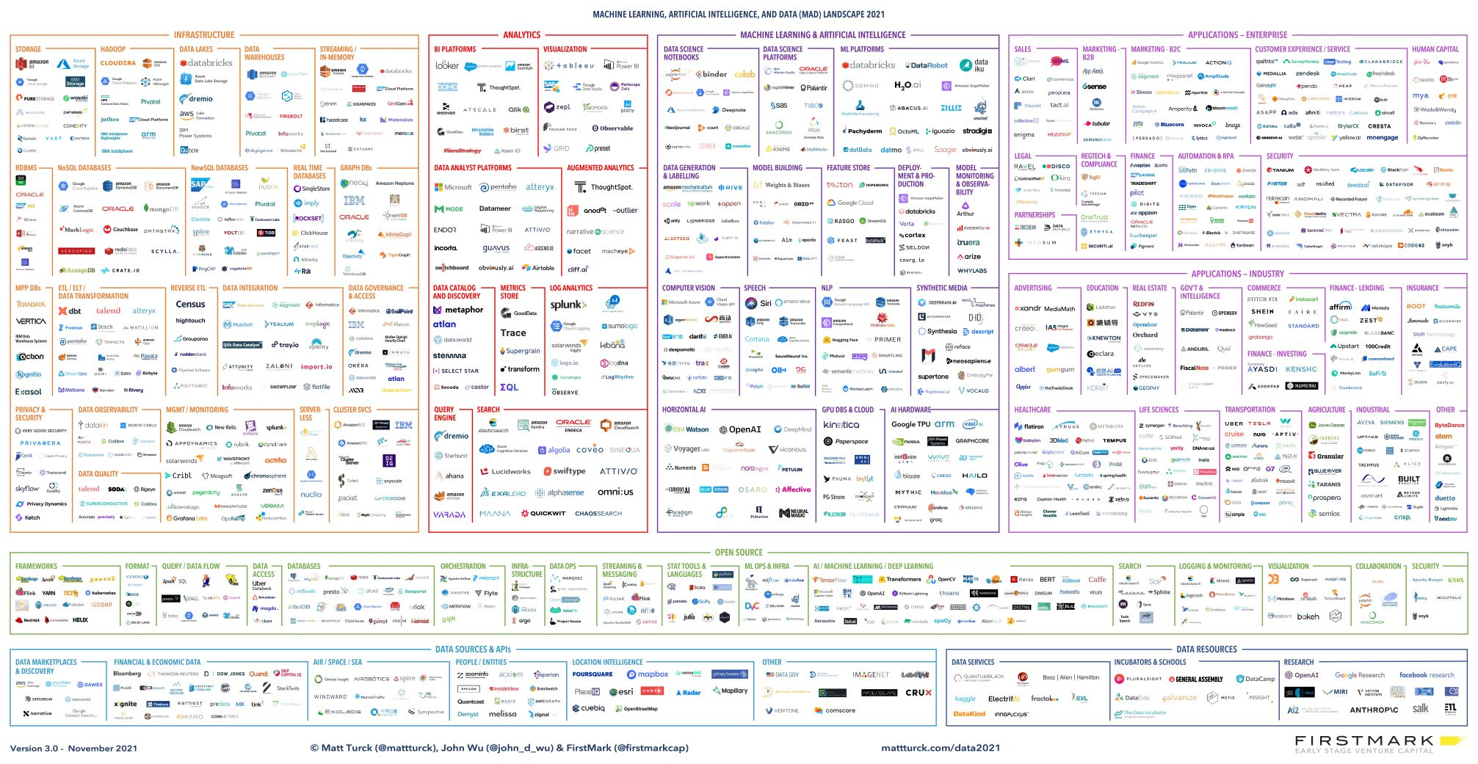
the modern data stack

Slide 6

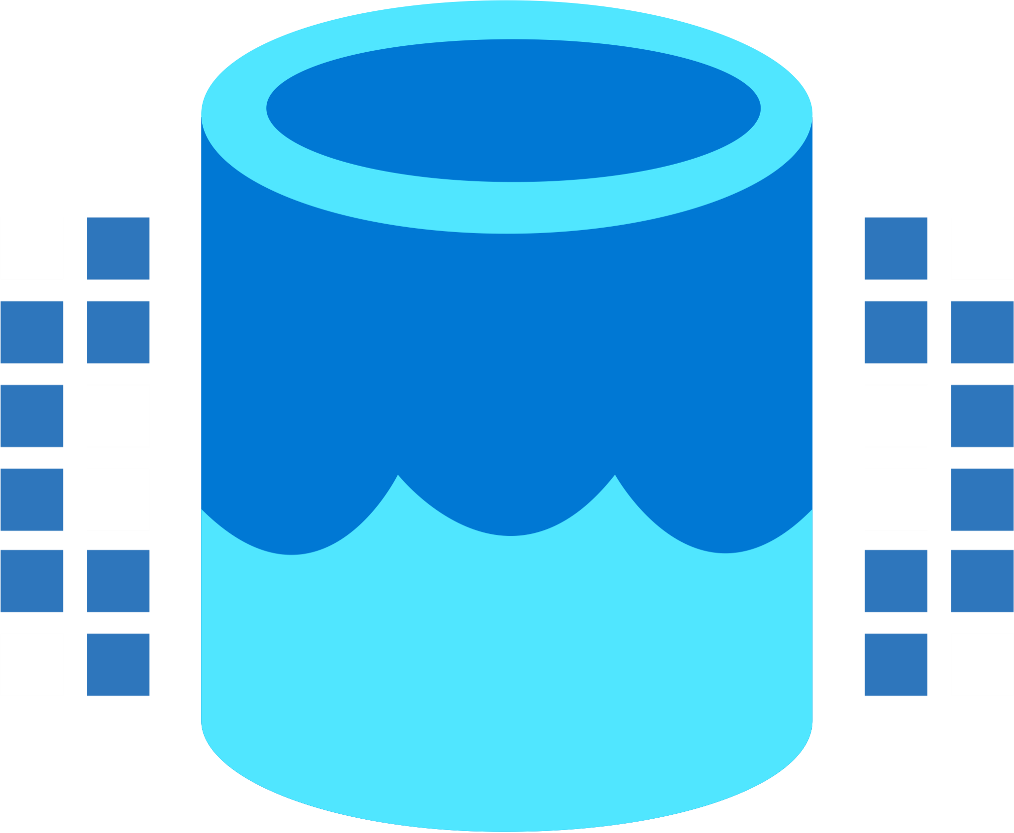




Microsoft Fabric
Data Integration
Data Lake
Spark Engines
Data
Warehouse
Real Time Analytics
Data
Science
Business
Intelligence
Governance
Unified analytics fabric
End-to-end analytics data fabric
From the data lake to the business user

Slide 7
Microsoft Fabric
Single…
Data
Integration
Data
Engineering
Data Warehousing
Real-
Time Analytics
Data Science
Business Intelligence
Onboarding and trials
Sign-on
Navigation model
UX model
Workspace organization
Collaboration experience
Data Lake
Storage format
Data copy for all engines
Security model
CI/CD
Monitoring hub
Data Hub
Governance & compliance
AI Assisted
Shared Workspaces
Universal Compute Capacities
OneSecurity
OneLake
SaaS foundation

Slide 8
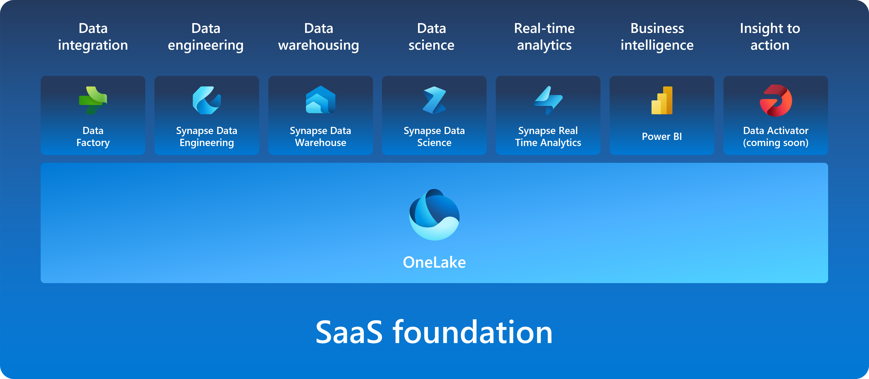
Microsoft Fabric

Slide 9
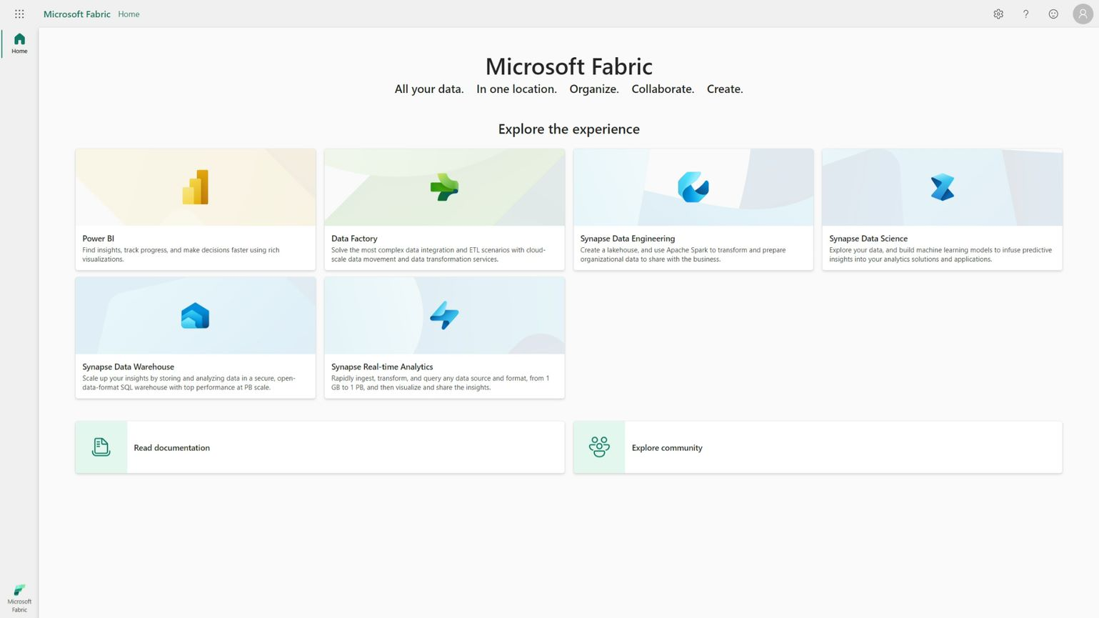
Persona Centric Experiences

Slide 10
… and everything will get Copilot

Slide 11
data storage

Slide 12
it’s all Delta
(Parquet)

Slide 13
OneLake for all Data
“The OneDrive for Data”
Data
Warehousing
Data
Engineering
Data Integration
Data
Science
Real
Time
Analytics
Business Intelligence
A single SaaS lake for the whole organization
Provisioned automatically with the tenant
All workloads automatically store their data in the OneLake workspace folders
All the data is organized in an intuitive hierarchical namespace
The data in OneLake is automatically indexed for discovery, MIP labels, lineage, PII scans, sharing, governance and compliance
OneLake Storage
Intelligent data fabric

Slide 14
One Copy for all computes
Real separation of compute and storage
Data
Warehousing
Data
Engineering
Data Integration
Data
Science
Real
Time
Analytics
Business Intelligence
All the compute engines store their data automatically in OneLake
The data is stored in a single common format
Delta – Parquet, an open standards format, is the storage format for all tabular data in Fabric
Once data is stored in the lake, it is directly accessible by all the engines without needing any import/export
All the compute engines have been fully optimized to work with Delta Parquet as their native format
Shared universal security model is enforced across all the engines
Serverless
Compute
T-SQL
Spark
KQL
Analysis Services
OneLake Storage
Finance
Customers 360
Service Telemetry
Business KPIs
Delta – Parquet Format
Delta – Parquet Format
Delta – Parquet Format
Delta – Parquet Format

Slide 15
One Copy for all computes
Universal security makes it real
Data
Warehousing
Data
Engineering
Data Integration
Data
Science
Real
Time
Analytics
Business Intelligence
All the compute engines store their data automatically in OneLake
The data is stored in a single common format
Delta – Parquet, an open standards format, is the storage format for all tabular data in Fabric
Once data is stored in the lake, it is directly accessible by all the engines without needing any import/export
All the compute engines have been fully optimized to work with Delta Parquet as their native format
Shared universal security model is enforced across all the engines
Serverless
Compute
T-SQL
Spark
KQL
Analysis Services
OneLake Storage
OneSecurity
Finance
Customers 360
Service Telemetry
Business KPIs
Delta – Parquet Format
Delta – Parquet Format
Delta – Parquet Format
Delta – Parquet Format

Slide 16



Taking One Copy to the next level
Shortcuts
Sharing data in OneLake is as easy as sharing files in OneDrive, removing the needs for data duplication
With shortcuts, data throughout OneLake can be composed together without any data movement
Shortcuts also allow instant linking of data already existing in Azure and in other clouds, without any data duplication and movement, making OneLake the first multi-cloud data lake
With support for industry standard APIs, OneLake data can be directly accessed by any application or service
Data
Integration
Data
Engineering
Data Warehousing
Real
Time Analytics
Data Science
Business Intelligence
OneLake Storage
Finance
Customers 360
Service Telemetry
Business KPIs
Azure
Amazon
Google

Slide 17

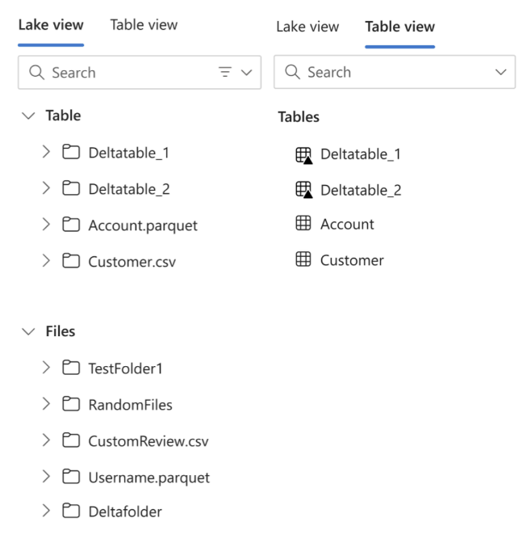
OneLake working with both files and tables

Slide 18
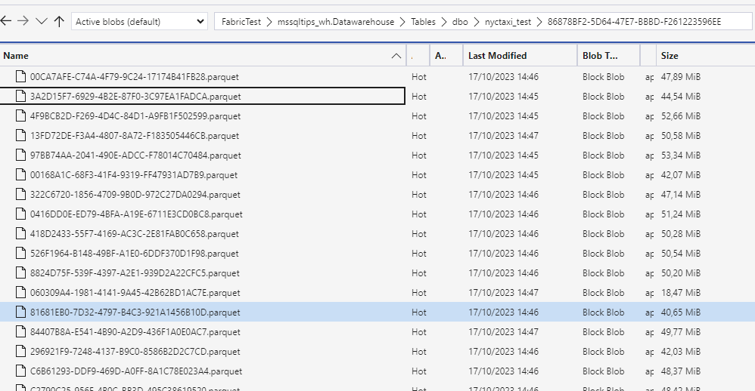
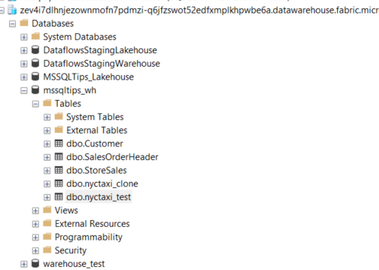

Slide 19
compute?

Slide 20
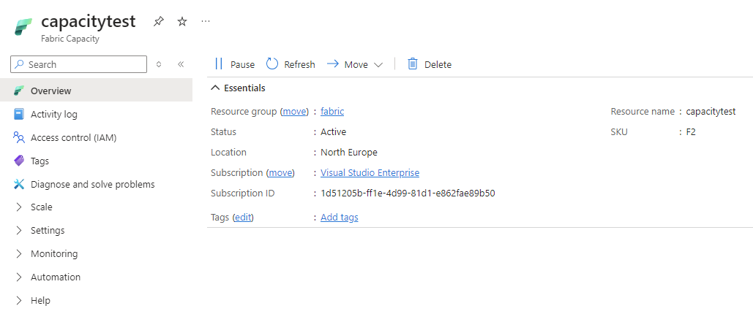
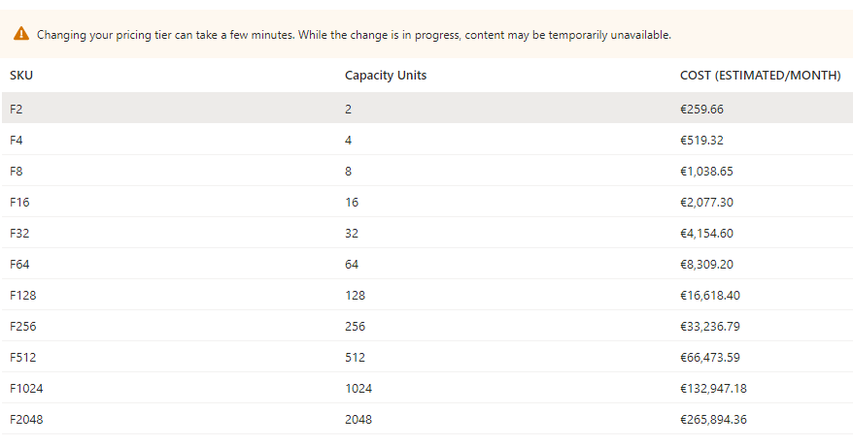
capacities

Slide 21
data engineering

Slide 22
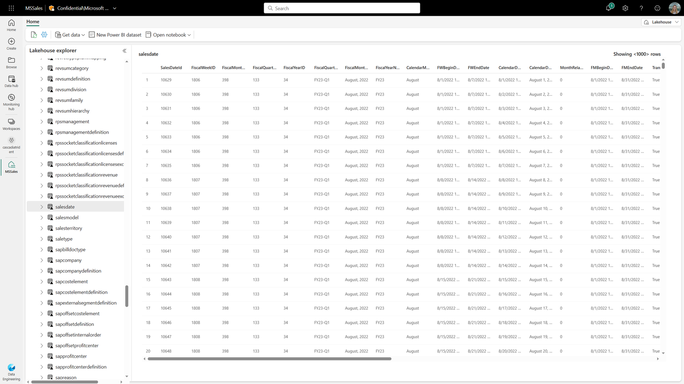
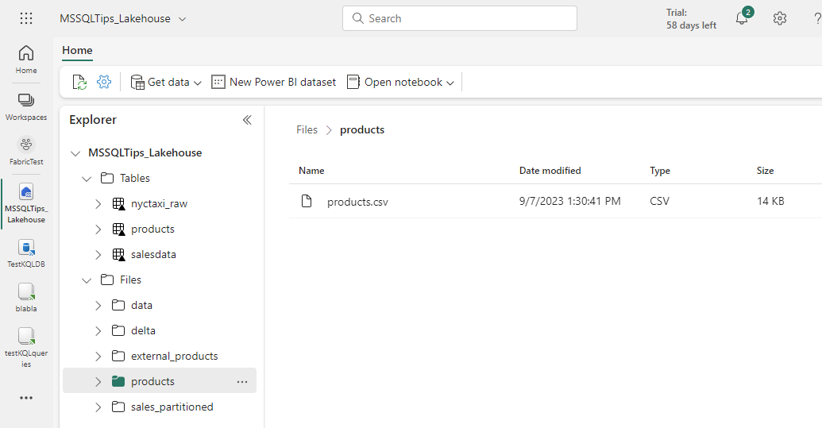
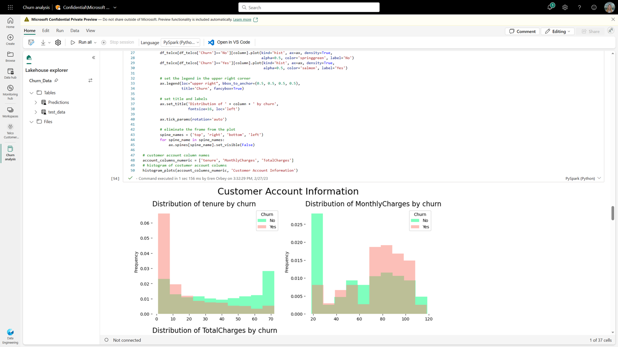
Data Engineering

Slide 23
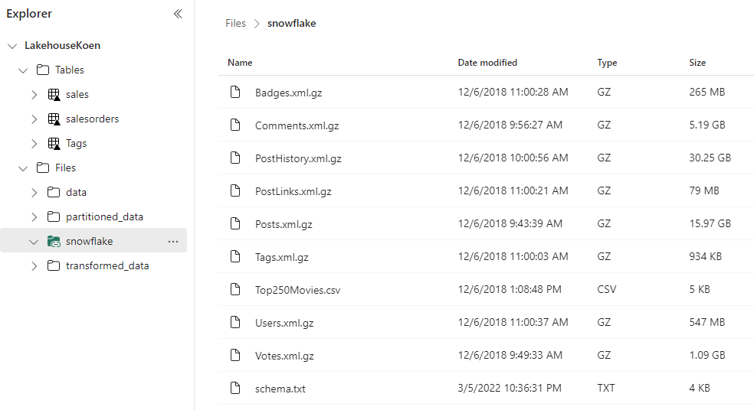
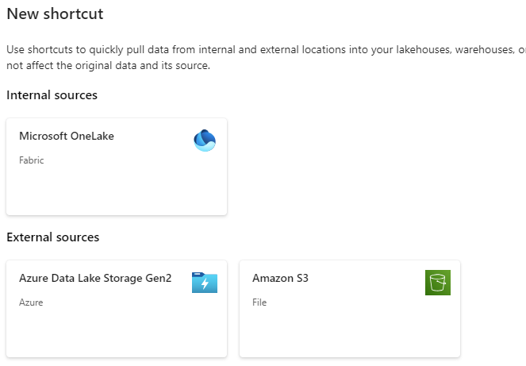
Shortcuts

Slide 24
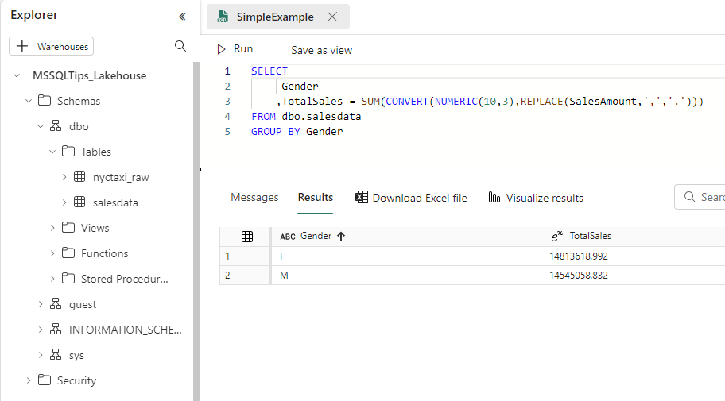
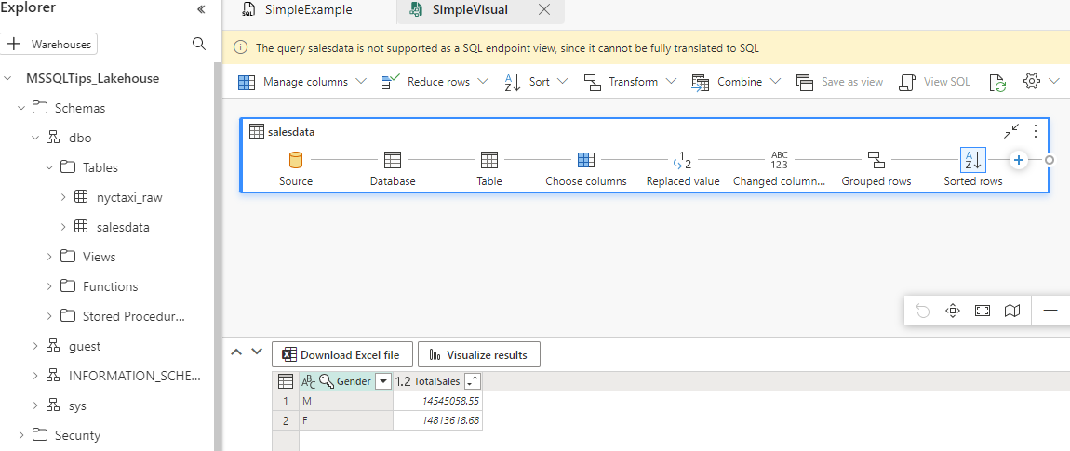
SQL Endpoint

Slide 25
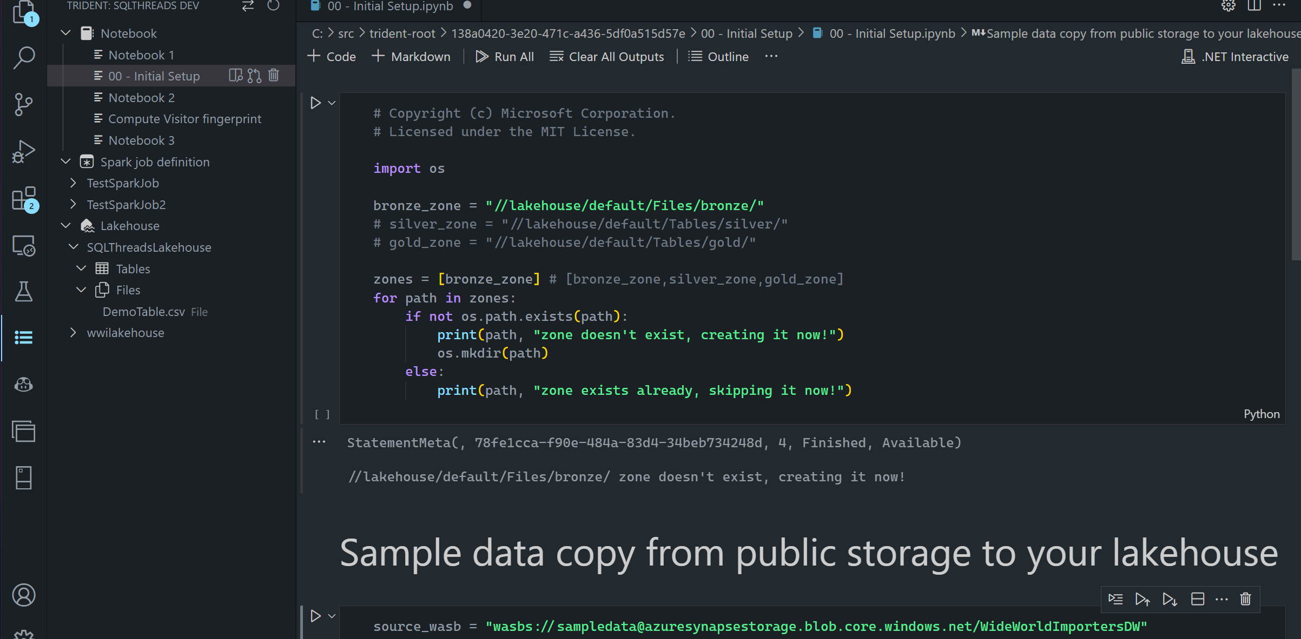
Notebooks in VS Code

Slide 26
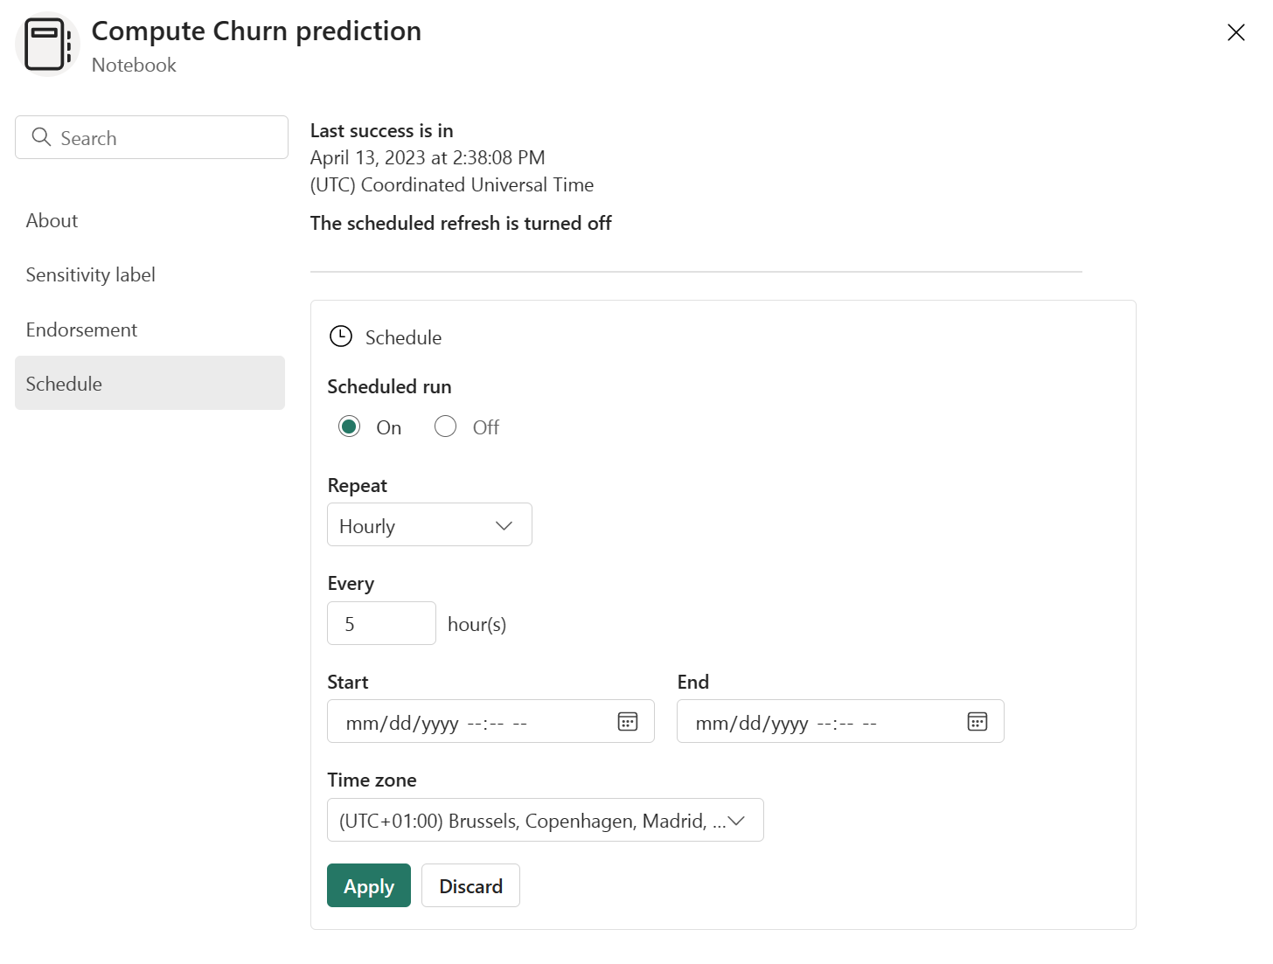
Schedule Notebooks

Slide 27
demo

Slide 28
data warehouse

Slide 29


Created in a workspace
Full T-SQL Commands
Synapse Data Warehouse
Several data ingestion methods
Automatically created with every LakeHouse
Read-only T-SQL Commands
SQL Endpoint
on the LakeHouse
Data ingested

Slide 30

this is not Synapse Dedicated SQL Pools

Slide 31
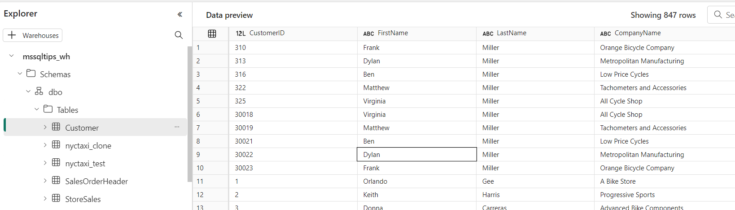
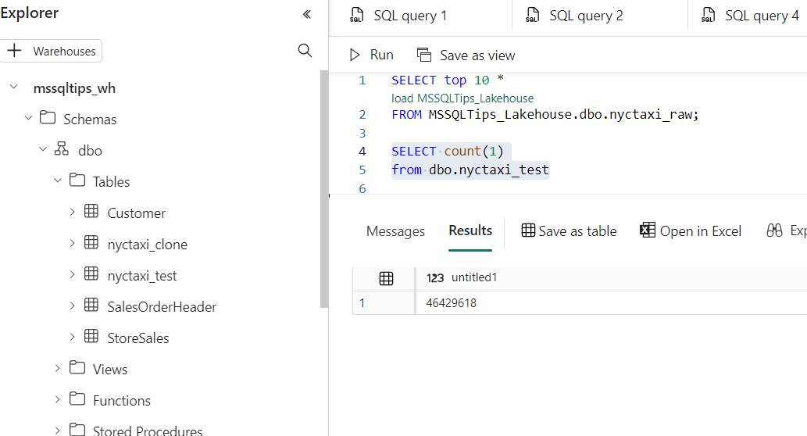
Build your warehouse

Slide 32
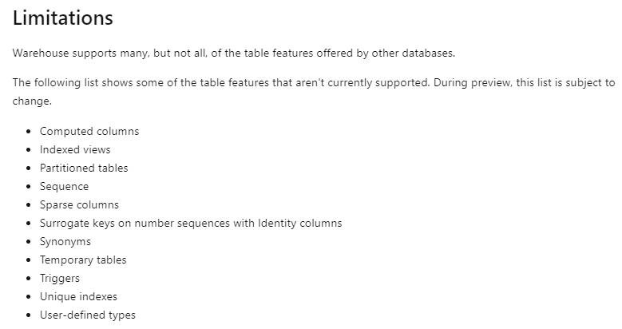

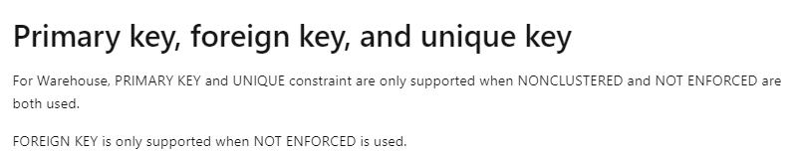
Notes:
surrogate keys are announced to be in the pipeline for Q1 2024

Slide 33
ingestion

Slide 34


Spark Job
Definitions
Data Flows
Notebooks
Data pipelines
Code-based pipelines
UI-based pipelines

Slide 35
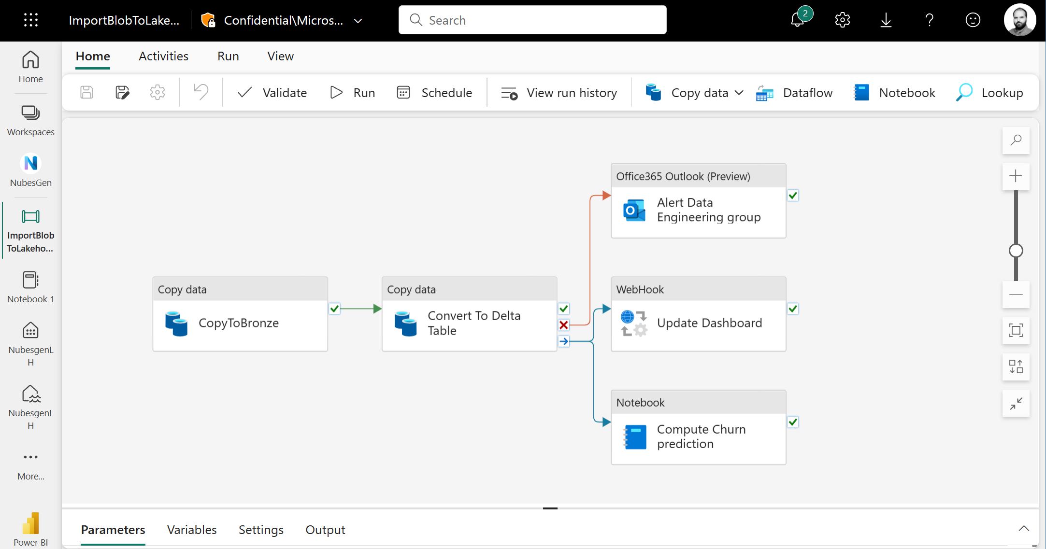

Slide 36
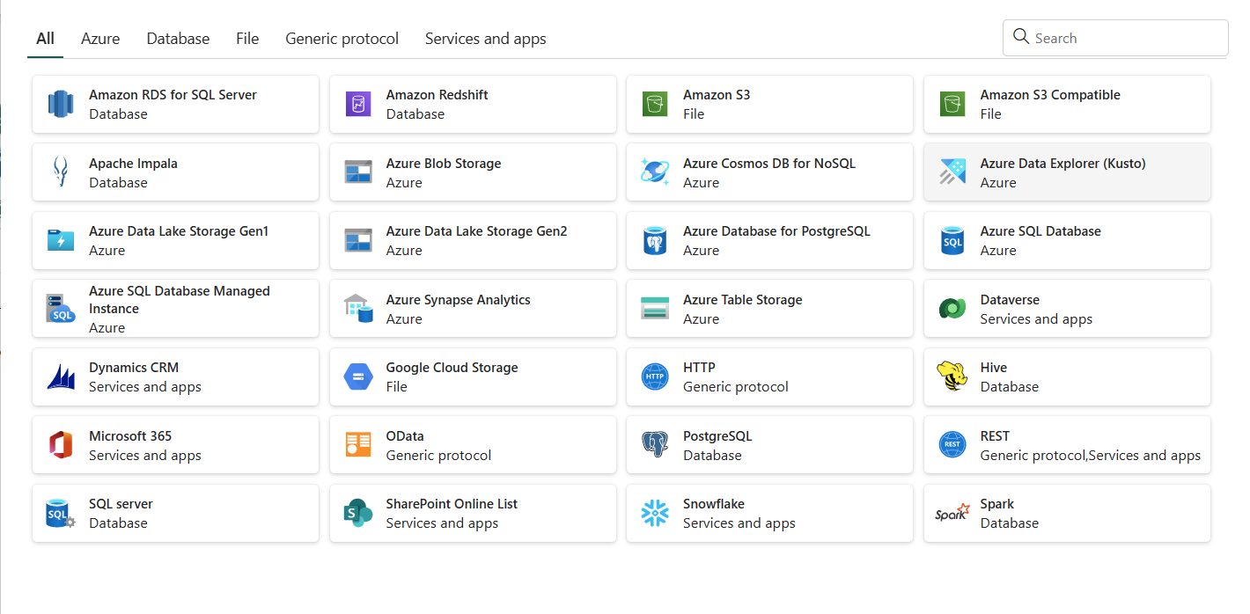

Slide 37
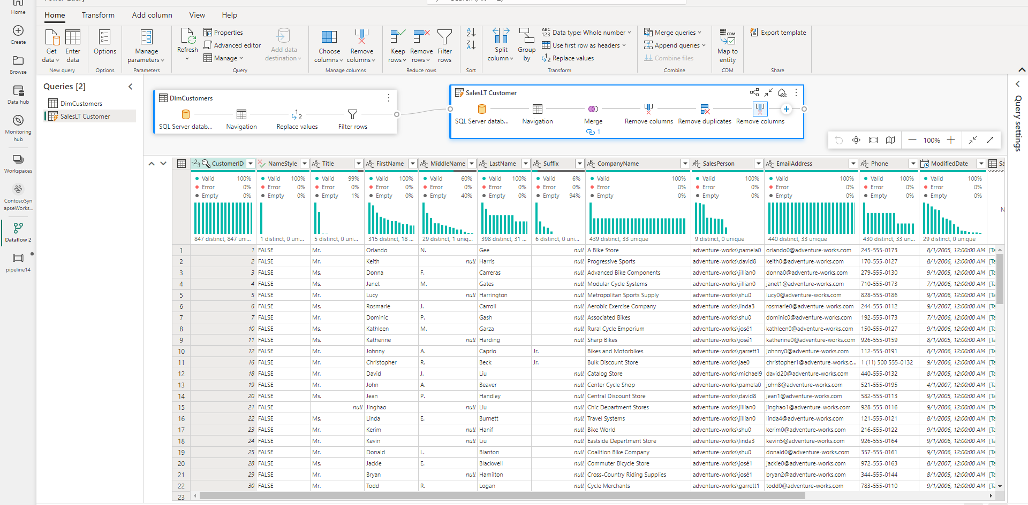

Slide 38
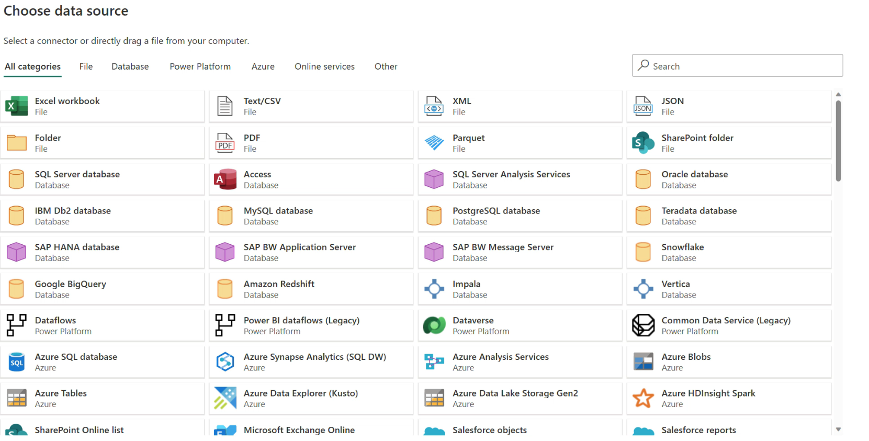

Slide 39
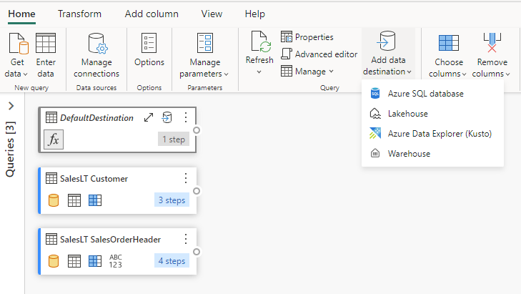
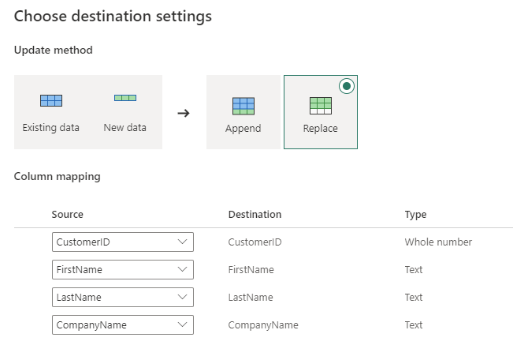

Slide 40
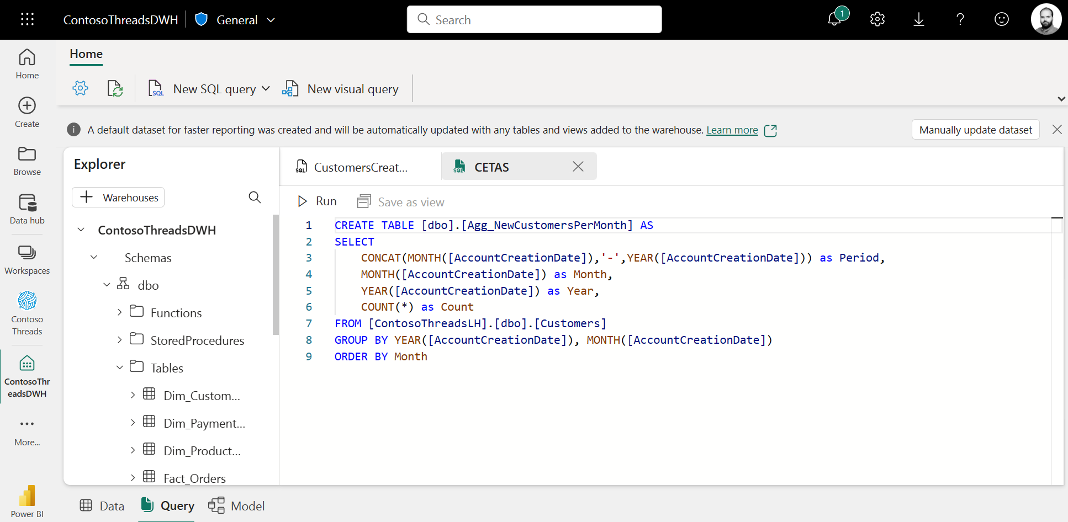
Notes:
or copy into

Slide 41
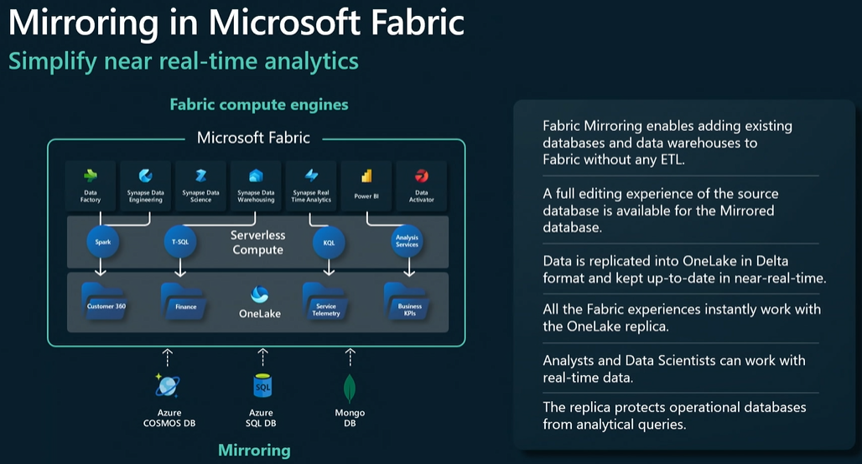
database mirroring

Slide 42
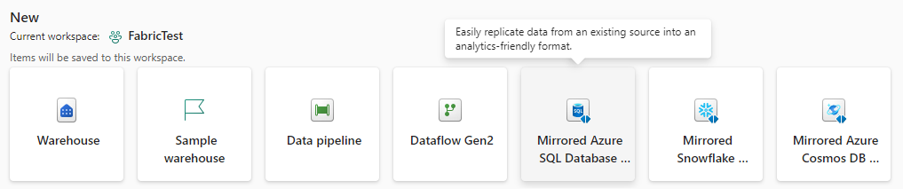
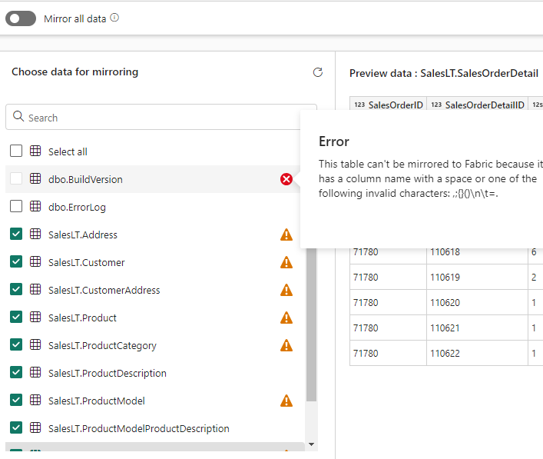
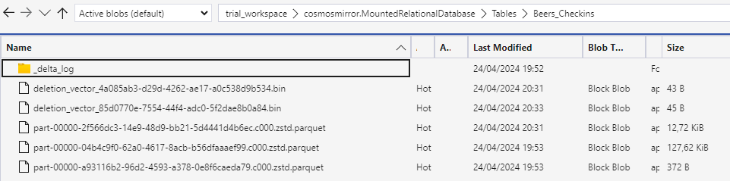
database mirroring

Slide 43
data science

Slide 44
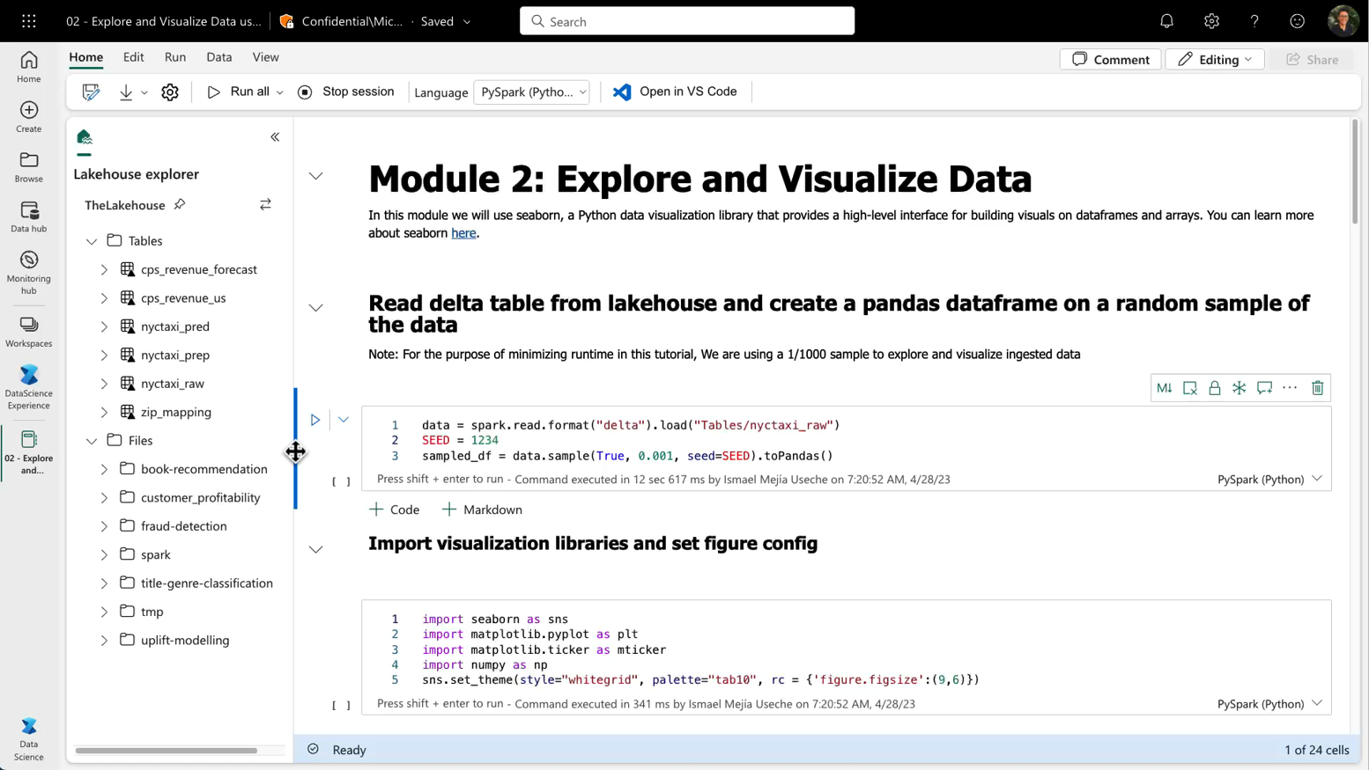
Notebooks

Slide 45
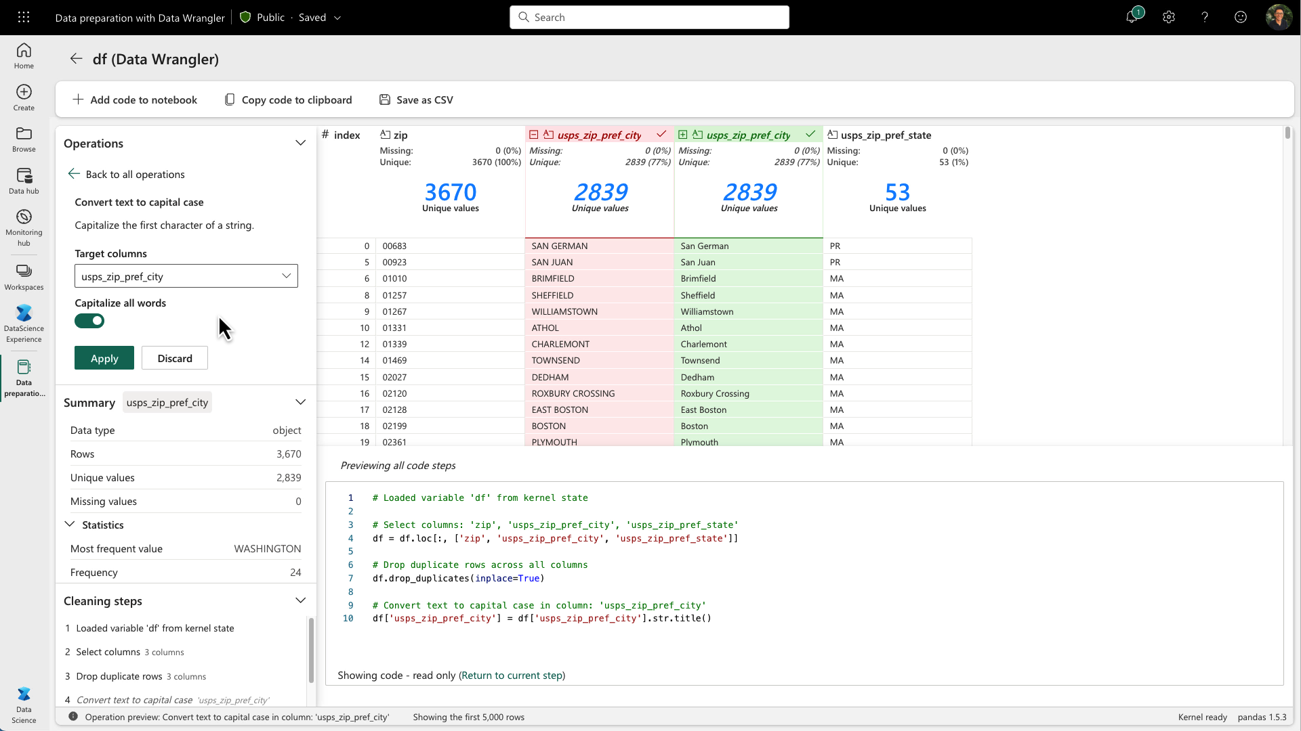
Data Wrangler

Slide 46


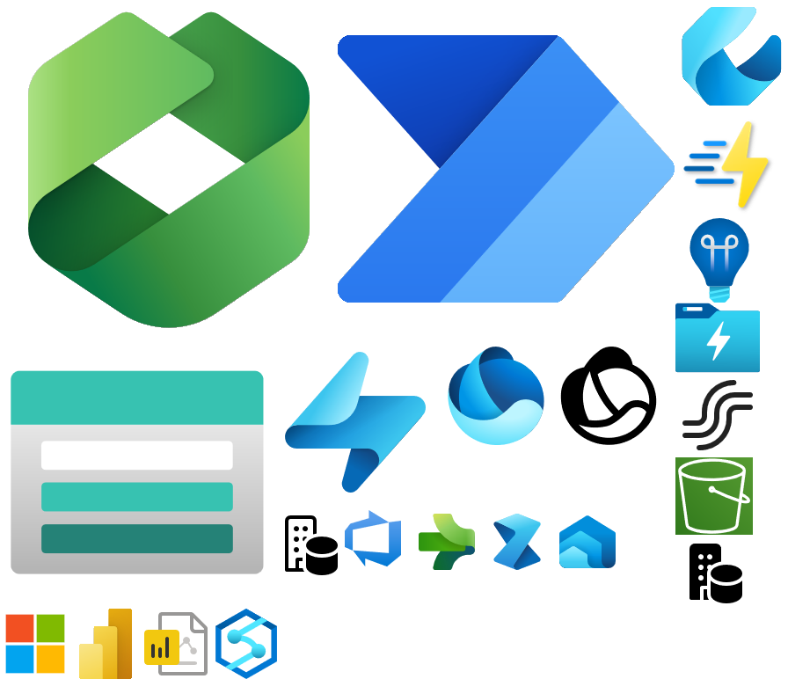



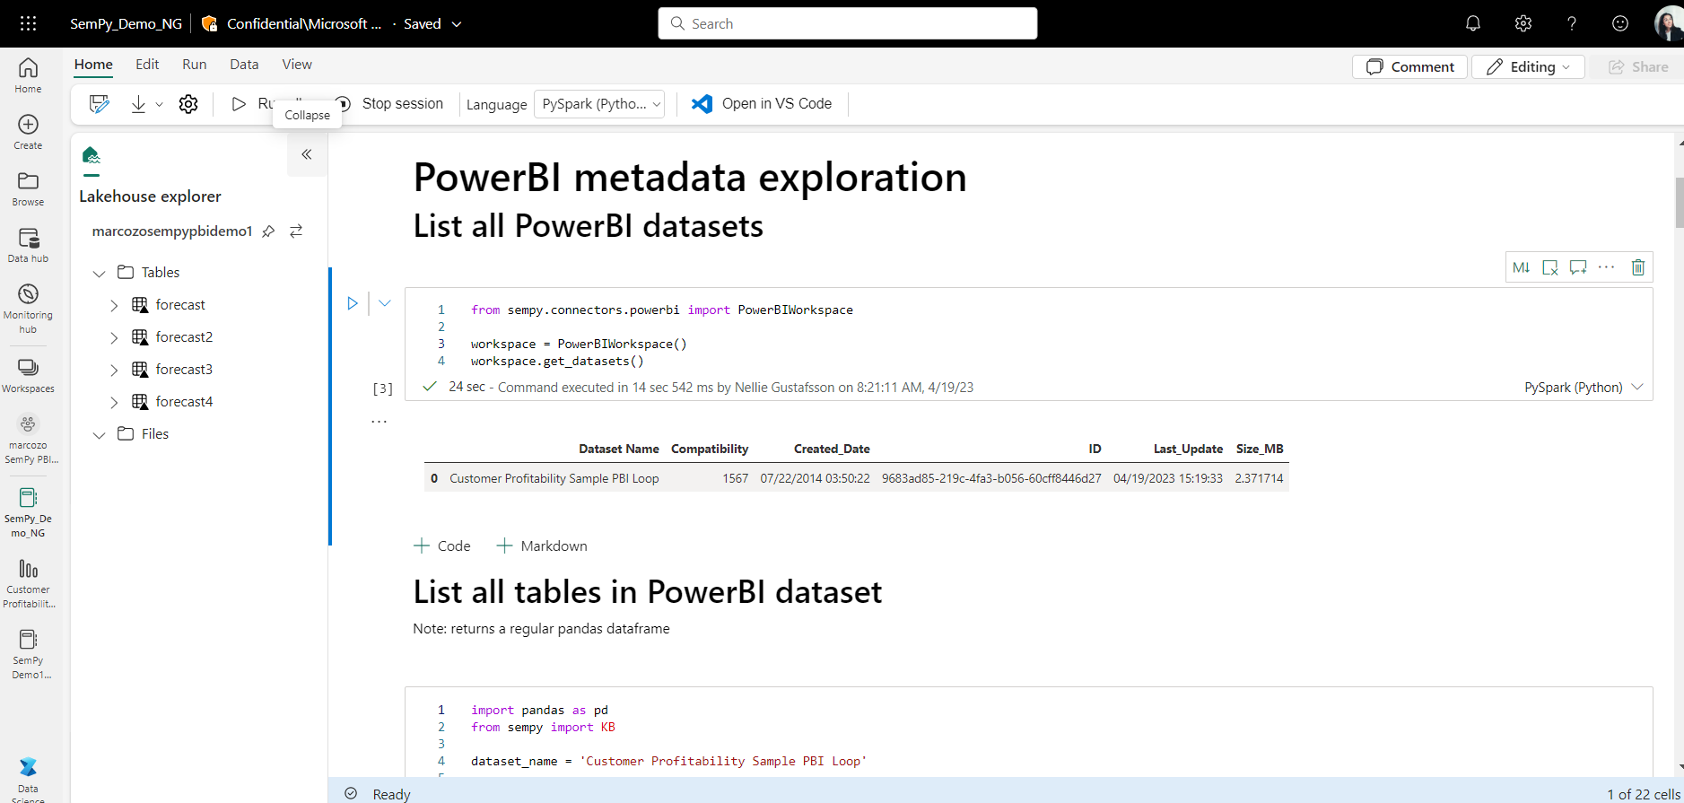
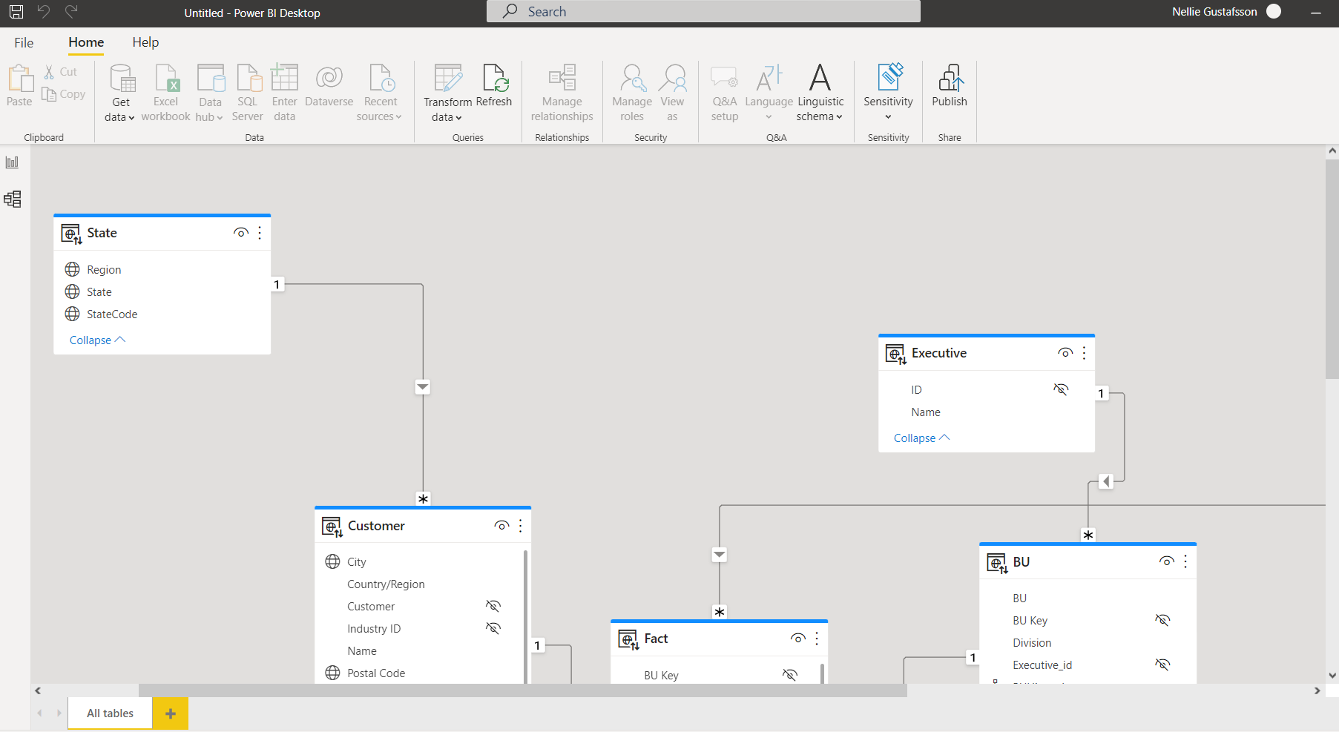

Semantic Link: Data Science and BI
Notebook
Notebook
PowerBI
Data Scientist
Data Analyst
Lakehouse

Slide 47



SynapseML and Microsoft AI services
Distributed ML Model Training
MLflow support
Cognitive Services
OpenAI LLMs
Notes:
SynapseML is an open-source Apache Spark library for machine learning. It enables Machine Learning at scale with distributed training of models and support for MLFlow.
SynapseML includes integrations with ready to use Machine learning services like Azure Cognitive Services for vision, speech, language processing and translation.
It also includes support for Azure OpenAI to enable access to large language models that are fine tuned and ready to use without any pain.
And of course Microsoft Fabric will also be powered by AI. One of the most exciting upcoming features is the copilot experience, which will leverage natural language processing support to do analytics and generate data preparation tasks on Notebooks.

Slide 48
real-time analytics

Slide 49

Paradigm shift in Data Consumption
Big Data Platforms
Terabytes of data
Low latency
High freshness
Streaming technologies
Index everything by default

Slide 50

Real-Time Analytics in Fabric - Reducing Complexity
Built on top off Azure Data Explorer
One Logical Copy
By-default streaming ingestion
By-default indexing everything
Time and Hash based data partitioning
Native support for structured, semi-structured and free text data
In-place transformation

Slide 51
Real-Time Analytics in Fabric - Simplifying
Tightly integrated with Fabric experiences
Mirroring to Lakehouse
By-default integration with event streaming sources
By-default integration with Power BI

Slide 52
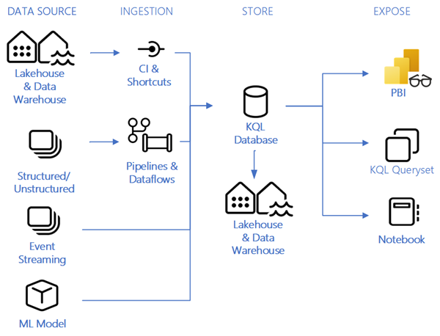

Slide 53
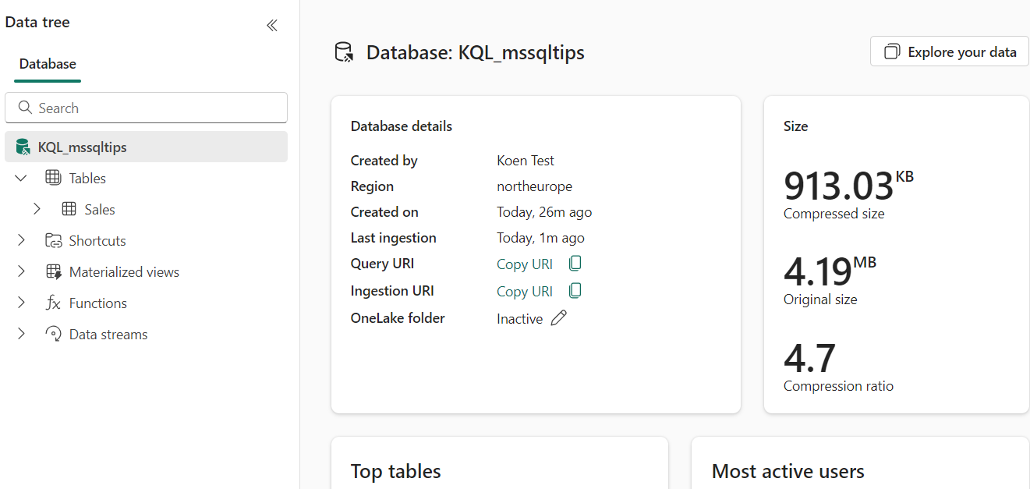
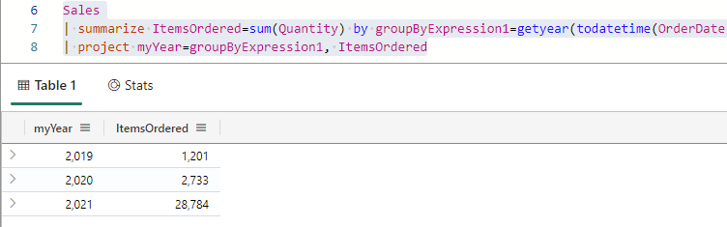

Slide 54
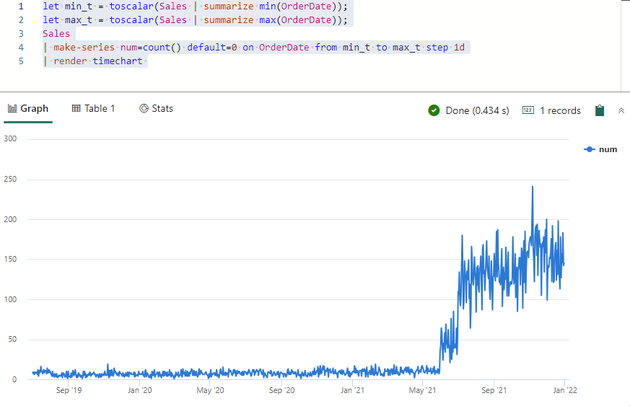

Slide 55
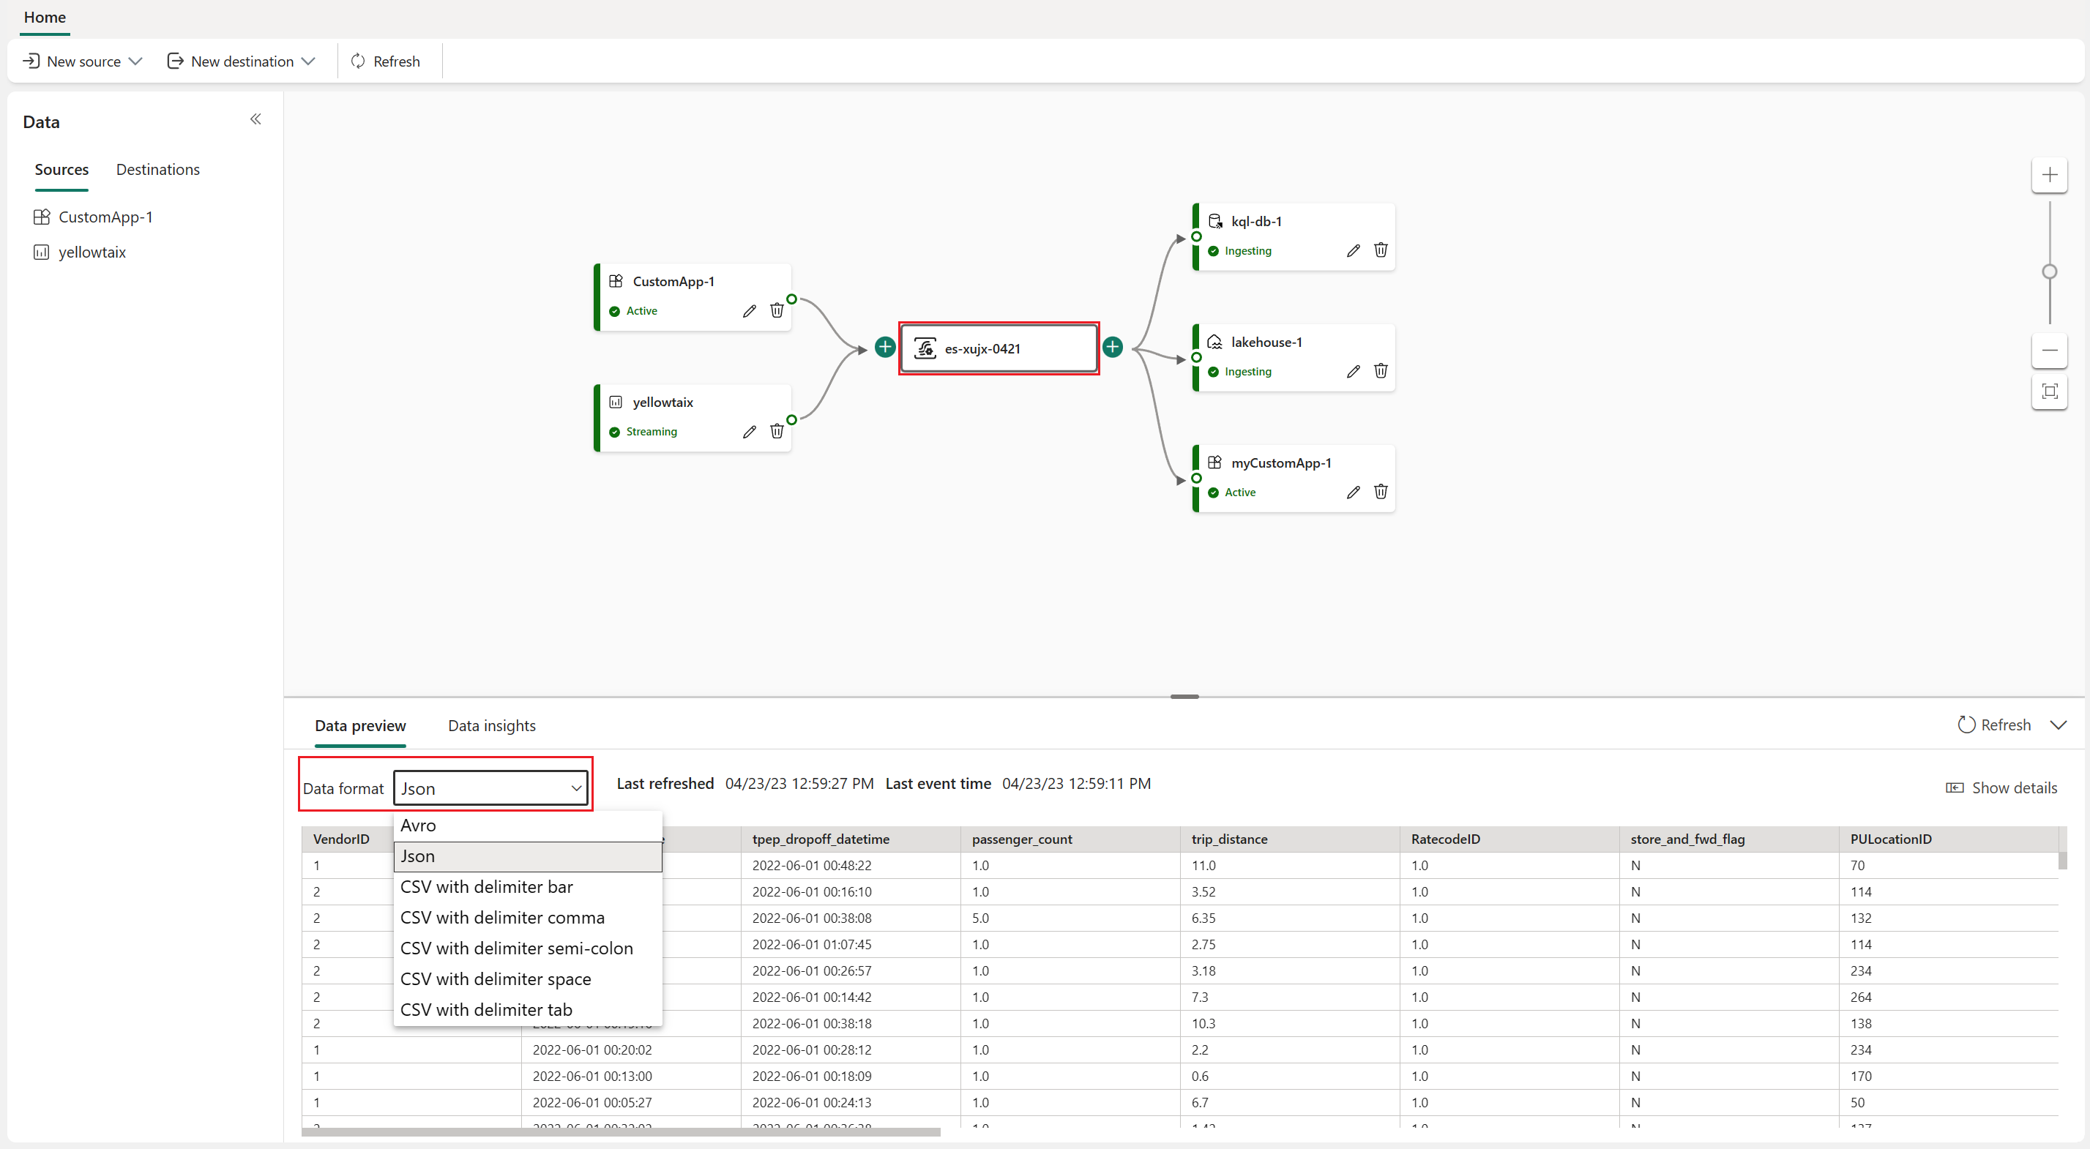

Slide 56
business intelligence

Slide 57
nothing changes for the average Power BI user

Slide 58
except…

Slide 59
“Direct Query Mode”
Parquet/Delta Lake
Data
Warehouse/
Lakehouse
Power BI
Analysis
Services
Scan
SQL
Queries
DAX
Queries
Tables
Reports
Slow, but real time
OneLake
“Import Mode”
Parquet/Delta Lake
Data
Warehouse/
Lakehouse
Power BI
Analysis
Services
DAX
Queries
Scan
Import
Latent & duplicative but fast
Tables
Reports
OneLake
Copy of
Tables

Slide 60
“Direct Query Mode”
Parquet/Delta Lake
Data
Warehouse/
Lakehouse
Power BI
Analysis
Services
Scan
SQL
Queries
DAX
Queries
Tables
Reports
Slow, but real time
OneLake
“Import Mode”
Parquet/Delta Lake
Data
Warehouse/
Lakehouse
Power BI
Analysis
Services
Scan
Import
DAX
Queries
Latent & duplicative but fast
Tables
Reports
OneLake
Copy of
Tables
“See-through Mode”
Parquet/Delta Lake
Data
Warehouse/
Lakehouse
Power BI
Analysis
Services
Scan
DAX
Queries
Perfect!
Tables
Reports
OneLake

Slide 61
data activator

Slide 62
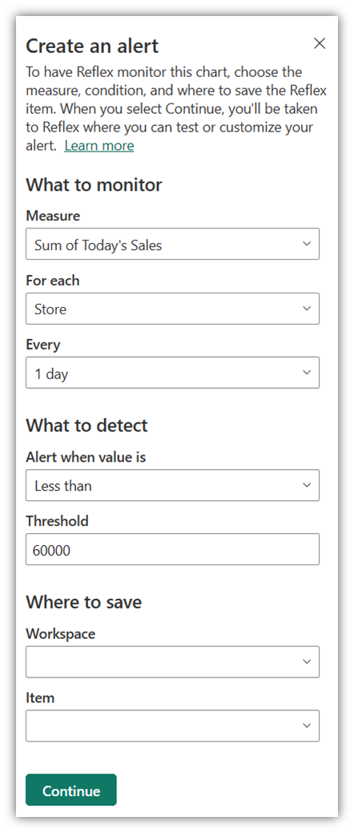
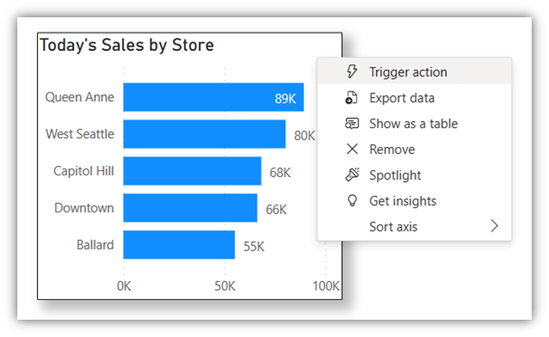

Slide 63
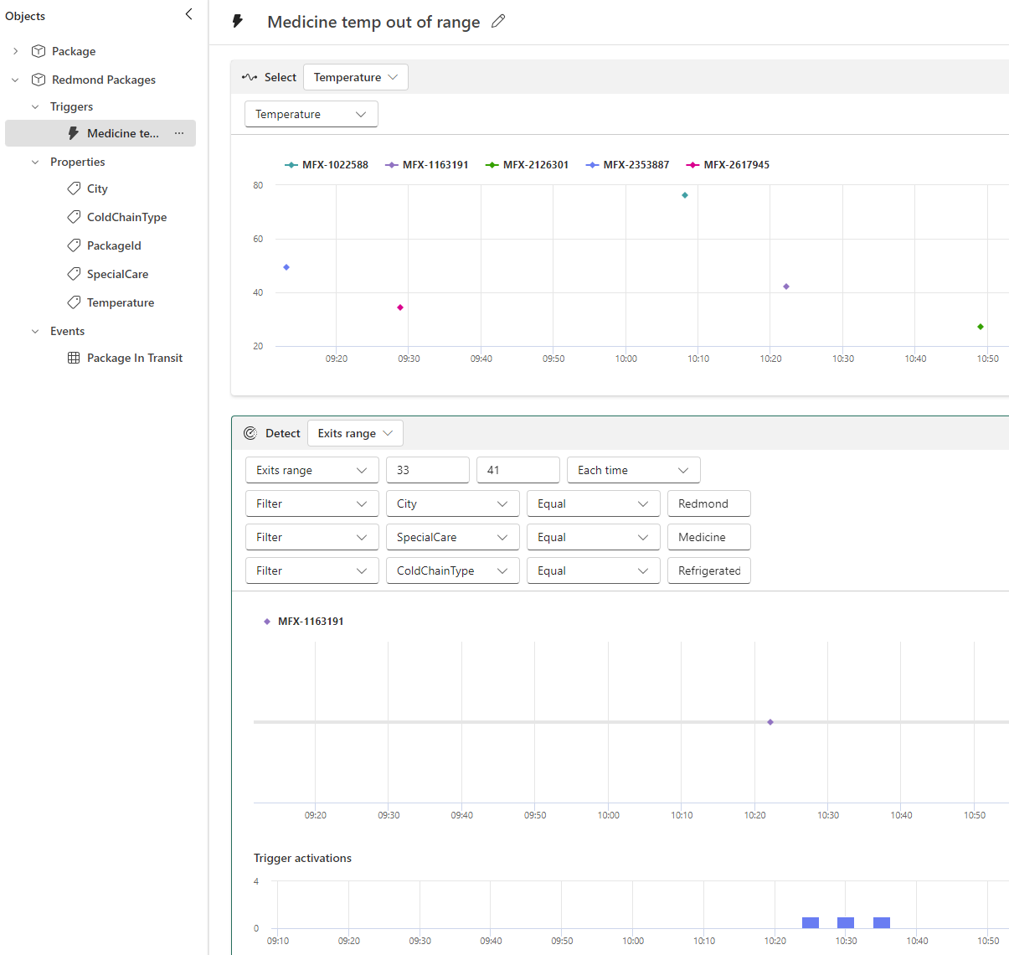

Slide 64
pricing

Slide 65

with Fabric the sky is the limit!
… as long as your wallet doesn’t have a limit

Slide 66
F SKU | P SKU | Pay-as-you-go (monthly) | Reserved Capacity P SKU (monthly)
F2 | - | $262.80 | -
F4 | - | $525.60 | -
F8 | EM | $1,051.20 | ~$750
F16 | EM2 | $2,102.40 | ~$1,500
F32 | EM3 | $4,204.80 | ~$3,000
F64 | P1 | $8,409.60 | ~$5,000-6,000
F128 | P2 | $16,819.20 | ~$10,000-12000
F256 | P3 | $33,638.40 | ~$20,000-24,000
F512 | P4 | $67,276.80 | ~$40,000
F1024 | P5 | $134,553.60 | ~$80,000
F2048 | - | $269,107.20
when below F64, every user needs Power BI Pro license
Azure SKU can be paused
can scale up or down
new: with F reserved capacity you get ~41% discount
basically Power BI Premium

Slide 67
conclusion

Slide 68

Data
Integration
Data
Engineering
Data Warehousing
Real
Time Analytics
Data Science
Business Intelligence
OneLake Storage
Finance
Customers 360
Service Telemetry
Business KPIs
Azure
Amazon
Google

Slide 69
is Fabric production ready?

Slide 70
… but it does have a lot of promise

Slide 71
resources
Get Started with Microsoft Fabric (free learning course)
What is Microsoft Fabric?
Microsoft Fabric blog
Get Started documentation
Microsoft Fabric @ mssqltips.com

Slide 72
thank you

